Slide 1

MSBD5013 Final Project M5 Forecasting – Accuracy and Uncertainty
TSE, Chun Lok (20517188)
YUEN, Zhikun (20505288)
Notes:
Hello, we are TSE Chun Lok and Yuen Zhikun. In the final project, we have worked on the m5 forecasting dataset.

Slide 2
M5 Forecasting Competition
The competition consists of two tracks:
Accuracy Track
Predict the 28 days ahead point forecast
Uncertainty Track
Predict 9 different prediction quantiles for uncertainty distribution
Notes:
The M5 forecasting competition consists of two complementary tracks in which accuracy and prediction intervals are required to predict.

Slide 3
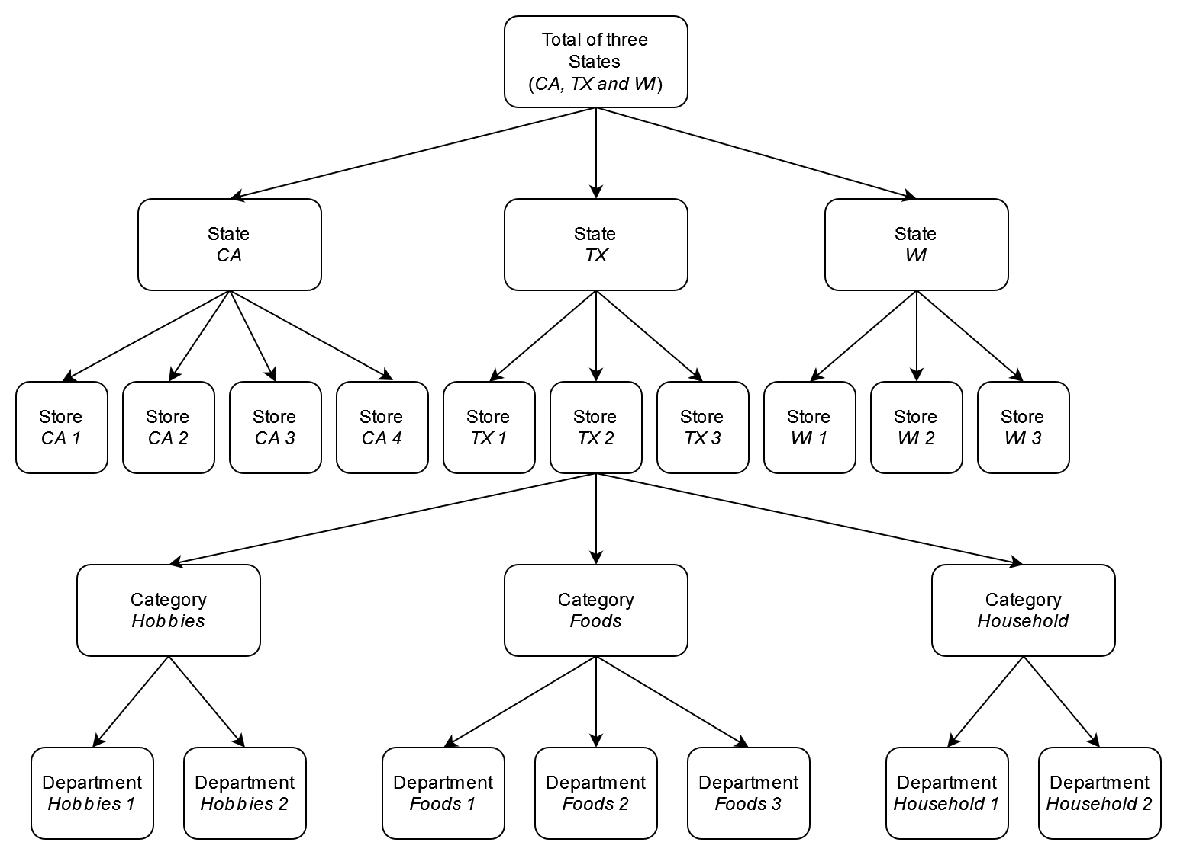
Data
The data can be aggregated to different levels
We hypothesize that a more fine-grained aggregation will lead to better results
Notes:
As described in the competition guide, the structure of the dataset can be organized as a hierarchical tree. Different aggregation levels of the products are possible. We hypothesize that a fine-grained aggregation will lead to better results.

Slide 4
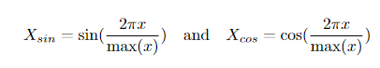
Data Preprocessing
Aggregating dataset
Sales of evaluation data are not included, we manually set the sales to be NaN in order to join the calendar data
Cyclic encoding
Date features cannot present well to a machine learning algorithm
Idea of cyclic encoding is similar to one hot encoding
We used Sine and Cosine function to transform the date features
Notes:
For the data preprocessing, since the sales of the evaluation data are not included, we manually set the sales of the forecasting days to be NaN in order to facilitate joining the tables. We also employ cyclic encoding to encode the dates into features. The reason is similar to one hot encoding where categorical features are used instead of continuous number values. We solve this by applying sine and cosine function to transform the date features.

Slide 5
Feature Engineering
Date features
Added day and week in month, whether the day is weekend
Lag and rolling features
Can be considered as simple baseline of the trend of a time series
Added lag features by shifting sales by 28 days
Used rolling window to slide over previous data to compute the rolling mean and standard deviation of the previous sales
The data is first shifted by 28 days and window sizes of 7, 30, 60, 90, 180 are used
Notes:
By observing the dataset, we added some extra date features such as week in month and whether the day is a weekend. Besides, we added lag and rolling features. The lag features are computed by shifting the sales by 28 days. We used multiple rolling windows to slide over the sales and obtain the mean and standard deviation of the data.

Slide 6
1.
Accuracy Track
Notes:
We are going to talk about the experiments we did in the accuracy track

Slide 7
LightGBM
To verify our hypothesis, we experimented on 3 different aggregation levels of the unit sales of all products
for each store
for each store and category
for each store and department
Notes:
One method is to use LightGBM, which is a gradient boosting framework. We can use to this to verify our previously mentioned hypothesis. We have experimented on 3 different aggregation levels of unit sales of the product.

Slide 8
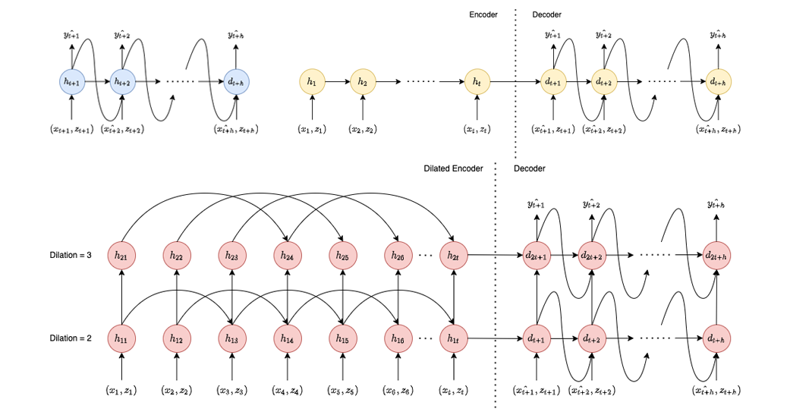

Sequence to Sequence Model
Single LSTM cell is unable to encode all long-term and short-term dependency in rolling and n-lag features
Used Seq2Seq models instead
Dilated Seq2Seq
Prevent gradient vanishing
More efficient
Attention Seq2Seq
Not only use the last hidden
unit of the encoder
Notes:
LSTM is another very popular sequential model for time series prediction. However, a single LSTM cell cannot encode all of the complex long-term and short-term dependency from input in each time step because in each time step, we input some time series also e.g. the rolling features and n-lag features. To solve this problem, we use seq2seq models instead. It contains an encoder and a decoder. In the encoder, the past time series can be encoded into the last hidden state and pass to the decoder for h-step ahead forecast. Also, we can implement attention seq2seq models to use all the output from each hidden states instead of just the last hidden states only. Except attention mechanism, we also try dilated LSTM in the encoder, which can help solve the problem of gradient vanishing because it reduce the average path length between nodes through different length of skip connection. Dilated LSTM can also reduce the computational time although this is not our main concern.

Slide 9
2.
Uncertainty Track
Notes:
Next, we will talk about the approaches we tried in uncertainty task.

Slide 10
Uncertainty Track
The required output is the 9 predicted prediction intervals
Since the competition is complementary, we can convert the accuracy results to uncertainty distribution
Two such methods are experimented
Naive method using residuals of a fitted model
Cumulative Distribution Function of Norma Distribution
Optimizing the Weighted Scaled Pinball Loss
Prophet
Notes:
In previous task, we need to predict h-step ahead forecast for the sales. In this task, we need to predict the 9 prediction intervals. There are several ways to compute the prediction intervals. The first one is to transform the sales prediction in previous accuracy task to prediction intervals directly. Another approach is to use the official metric as an objective function to optimize the prediction from the model directly. Finally, we also try a non-linear time series model provided by Meta called Prophet.

Slide 11
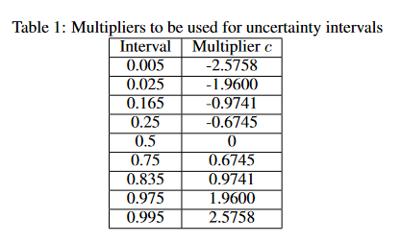
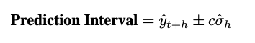
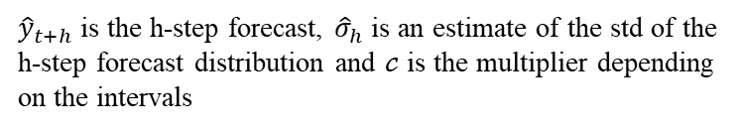
Naive Method
Baseline
Uses what is left over after fitting a model
Use 9 multipliers to generate uncertainty intervals
Round negative predictions to 0
${\hat{y}}_{t+h}$ is the h-step forecast, ${\hat{σ}}_{h}$ is an estimate of the std of the h-step forecast distribution and $𝒸$ is the multiplier depending on the intervals
Notes:
The first approach we tried is we use the prediction interval function in time series directly. In this function, we assume the forecast errors are normally distributed, so that we can compute the uncertainty with the standard deviation of the h-step ahead forecast distribution and a multiplier converted from normal distribution.

Slide 12
Cumulative Distribution Function
Prediction intervals are mapped from [0, 1] to real number line
Multiply a coefficient that is found based on trial and error (Grid search), higher level aggregation uses larger coefficient.
Normalizing the mapped value using CDF of normal distribution
Multiplied to accuracy result to generate uncertainty distribution
Method is not scientific
Notes:
Another approach we tried is using CDF to transform sales prediction to uncertainty directly. We first map the [0, 1] interval to the entire real line and then multiply a coefficient which was tuned by grid search with smallest error. We then normalize the mapped value using CDF of normal distribution and then multiply with the sales prediction to generate the uncertainty distribution. Although, this approach achieves pretty good results, it is not scientific.

Slide 13
Weighted Scaled Pinball Loss
Weighted Scaled Pinball Loss is the official metric for Uncertainty Track
Only requires actual sales as ground truth
Can directly optimize the Seq2Seq models with 9 quantile outputs
Notes:
In the last two approaches, we transform the sales forecast to uncertainty directly. However, this may not fit the official metric in the uncertainty task. Therefore, in this approach, we optimize the output from the seq2seq models directly and use the WSPL function as an objective function. This function only need the sales price as the ground truth label so we can optimize our model very easily. The only difference is that we need to change the number of output of the last fully-connected layer form 1 to 9.

Slide 14
Prophet
Used Open-sourced version by Meta
Identify strong seasonality and holiday effects
Robust for missing data and shifting trends
Directly outputs probability forecast
Notes:
The last approach we tried is a time series model, called Prophet, provided by Meta. It is suitable for time series data with strong seasonality and holiday effects and it is robust for missing data and shifting trends. The package can also outputs the prediction intervals to us directly.

Slide 15
3.
Accuracy Track Results
Notes:
Onto the results of the accuracy track.

Slide 16
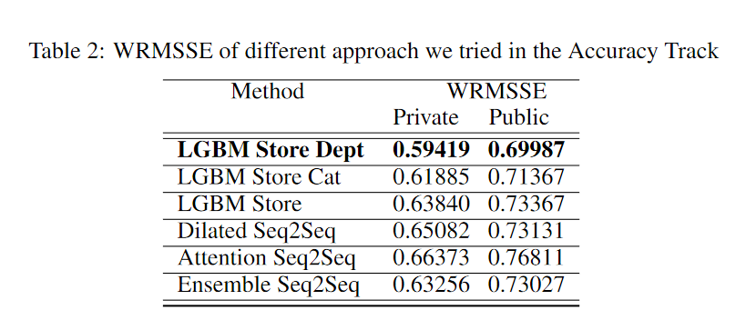
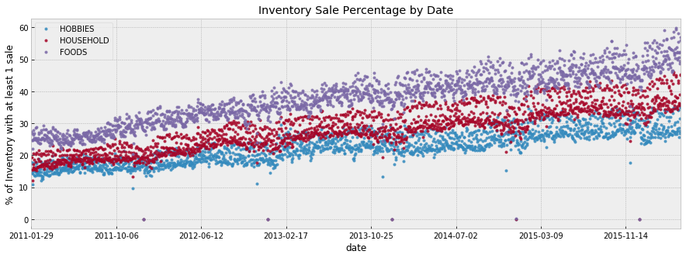
Results
From the results of the Accuracy Track, we indeed observe that a fine-grained approach achieves the best score
The dataset may contain drastically different purchasing behavior for different products
E.g., food products are consumed quickly whereas household products are relatively long-lasting.
Notes:
Our LightGBM aggregated by Store and department performed the best. We indeed see an increase in both private score and public score when we used a more fine-grained approach, verifying our hypothesis. This is because different product types consumes at different speeds.

Slide 17
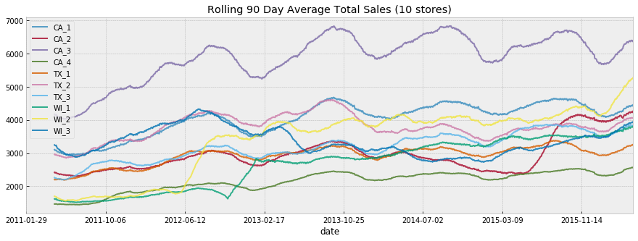
Results
Different state and different stores can also vary significantly
Different state may have different preferences in food and hobbies
Location of different stores also affect the sales
Notes:
We also observe that different stores even in the same state have significantly different sales. For example, sales of CA_3 is much higher than that of CA_4. Therefore, by using a fine-grained approach, we can predict the products more accurately.

Slide 18
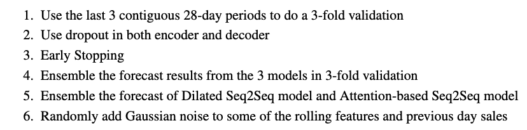
Sequence to Sequence Models
Dilated Seq2Seq better than attention-based Seq2Seq
Ensemble achieves lower WRMSSE
Still large variance (large gap between private and public LB)
Approach that we used in Seq2Seq to avoid high variance:
Notes:
In the result of Seq2Seq models in accuracy task, the dilated Seq2Seq model perform slightly better than the attention-based Seq2Seq model. Later we ensemble the two results with averaging to get a even better result. In time series forecasting, overfitting is a very serious problem that we need to consider. To prevent high variance, we apply some common approaches like k-fold validation, dropout, early stopping and ensemble. One interesting approach is that we randomly add gaussian noise to some of the input time series features to prevent overfitting the data and the noise in the origin time series. Among all approaches we tried in accuracy task, LGBM store department achieve the best result, even better than Seq2Seq models in the accuracy task.

Slide 19
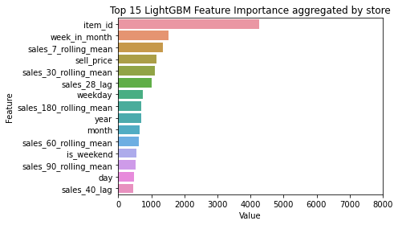
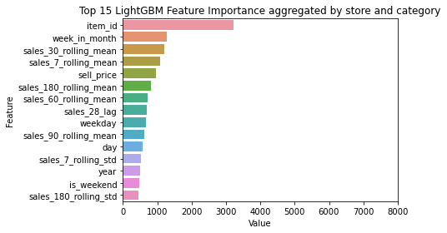
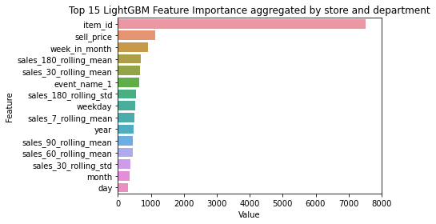
Feature Importance (LightGBM)
Item_id is overwhelmingly important
Our engineered features are also top on the list
Aggregated By Store and Category
Aggregated By Store and Department
Aggregated By Store
Notes:
For the feature importance of LightGBM models from the 3 experiments. We observe that item_id is overwhelming important. Besides, our engineered features such as week in month and rolling means are top of the list.

Slide 20
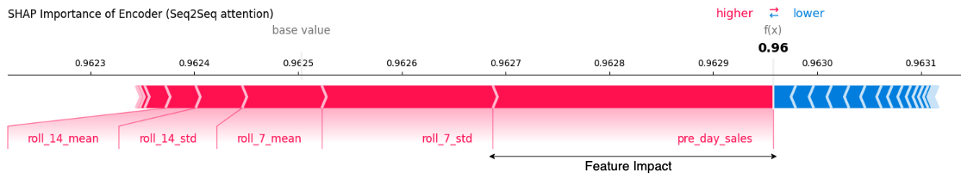
Feature Importance (Seq2Seq)
Used SHapley Additive exPlanations (SHAP)
Features are visualized as “forces”
Each feature is a force that either increases (red) or decreases (blue) the prediction
Wider range = larger impact
Recent sales information has larger impact
Notes:
To observe the input features importance of the Seq2Seq models, we use an approach called SHapley Additive exPlanations (aka SHAP). In this figure, we can view each feature as a force that either increase or decrease the prediction and wider range means larger impact. We can see that the more recent data have a larger impact to our forecast in Seq2Seq models.

Slide 21
4.
Uncertainty Track Results
Notes:
Next, we will show our result in the uncertainty task.

Slide 22
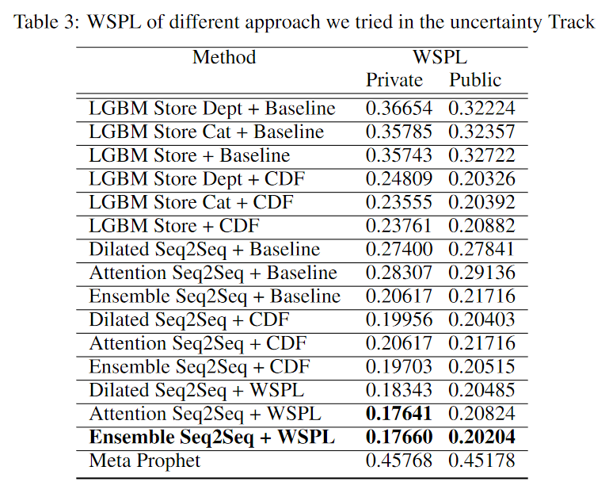
Results
Naive baseline is bad
CDF is better
Seq2Seq is better than LGBM in the transformation, even though LGBM is better in accuracy
Seq2Seq is the best
Attention-based Seq2Seq + WSPL
better than Ensemble
Attention-based is better than dilated
Seq2Seq which is different from accuracy task
Prophet is the worst
Only used sales data
took 80 hours to complete
Notes:
Interestingly, no matter what approaches we tried in the uncertainty task. Seq2Seq models perform better than LightGBM, even we use naive approach and CDF to converge the prediction interval from accuracy task directly. In the first two approaches, both of them transform uncertainty directly. CDF is better than the naïve approach. Using the WSPL function to optimize the seq2seq models achieve the best result which is within our expectation. Another interesting point is that, attention-based approach performs better than dilated seq2seq model which is different from the accuracy task. Prophet is the worst and most time consuming approach, it takes nearly 80 hours to run even we use multiprocessing with all our 24 CPU to run.

Slide 23
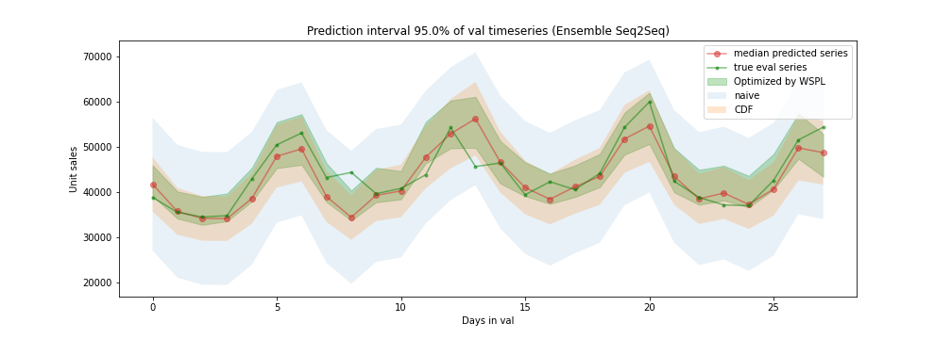
Results
Visualization of 95% prediction interval of ensemble Seq2Seq
Result: Optimized By WSPL >> CDF >> Naive Method
Our observation: A better should have a narrower prediction interval
Notes:
To visualize some of our result, we plot the 95% prediction intervals of ensemble seq2seq models with different approaches. We can see that the lowest the WSPL is , the narrow the prediction interval is. Naïve base has the worst result among these three methods and its gap of prediction interval is the largest.

Slide 24
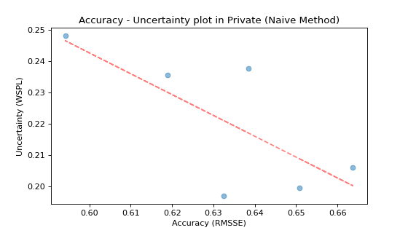
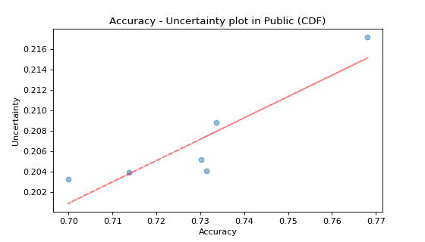
Relationship between Accuracy and Uncertainty
Plots of private leaderboard and public leaderboard does not agree
If the data split in private and public leaderboard is i.i.d., then hard to observe any correlation between accuracy and uncertainty tasks.
Notes:
We also try to observe any relationship between the accuracy task and uncertainty task. Therefore, we plot the metric scores of the two tasks in one plots. The six points are all the LGBM result and Seq2Seq models. The uncertainty result in here was transformed by CDF from accuracy task to uncertainty task directly. In both private and public leaderboard, we can observe some linear relationship, but they are inverse in the two data splits. If the two data are iid, it is hard to tell any observation from here.

Slide 25
Conclusion
Accuracy Track
LightGBM with private score = 0.59419
Uncertainty Track
Ensemble Seq2Seq model with private score = 0.17660
Notes:
To conclude, for the accuracy track, our best LightGBM model achieved private score of 0.594. For the uncertainty track, our best ensemble Seq2Seq model achieved private score of 0.177.

Slide 26
Thanks!
Notes:
That’s the end of our presentation

